Slide 1
Status
RPM readings
Thrust Measurement
Power Measurement from Pixhawk (to be calibrated but got it)
FOM
U, Vx, V, Re, phi, psi estimates based on analysis
Throttle demand sent as constant PWM signal to improve repeatability (all run from laptop now)
12V power supply (no need to recharge batteries constantly)
ALL readings taken as averages over a 20-60 second interval
Diffusers PTO

Slide 2
Diffusers
SIGMA | Length | FOM (approx. mean) | Notes
0.80 | Short | 0.354 | Expected lowest
1.00 | Short | 0.393 | Baseline
1.26 | Short | 0.394 | SEPERATED
1.26 | Long | 0.411 | Notable increase, more attached

Slide 3
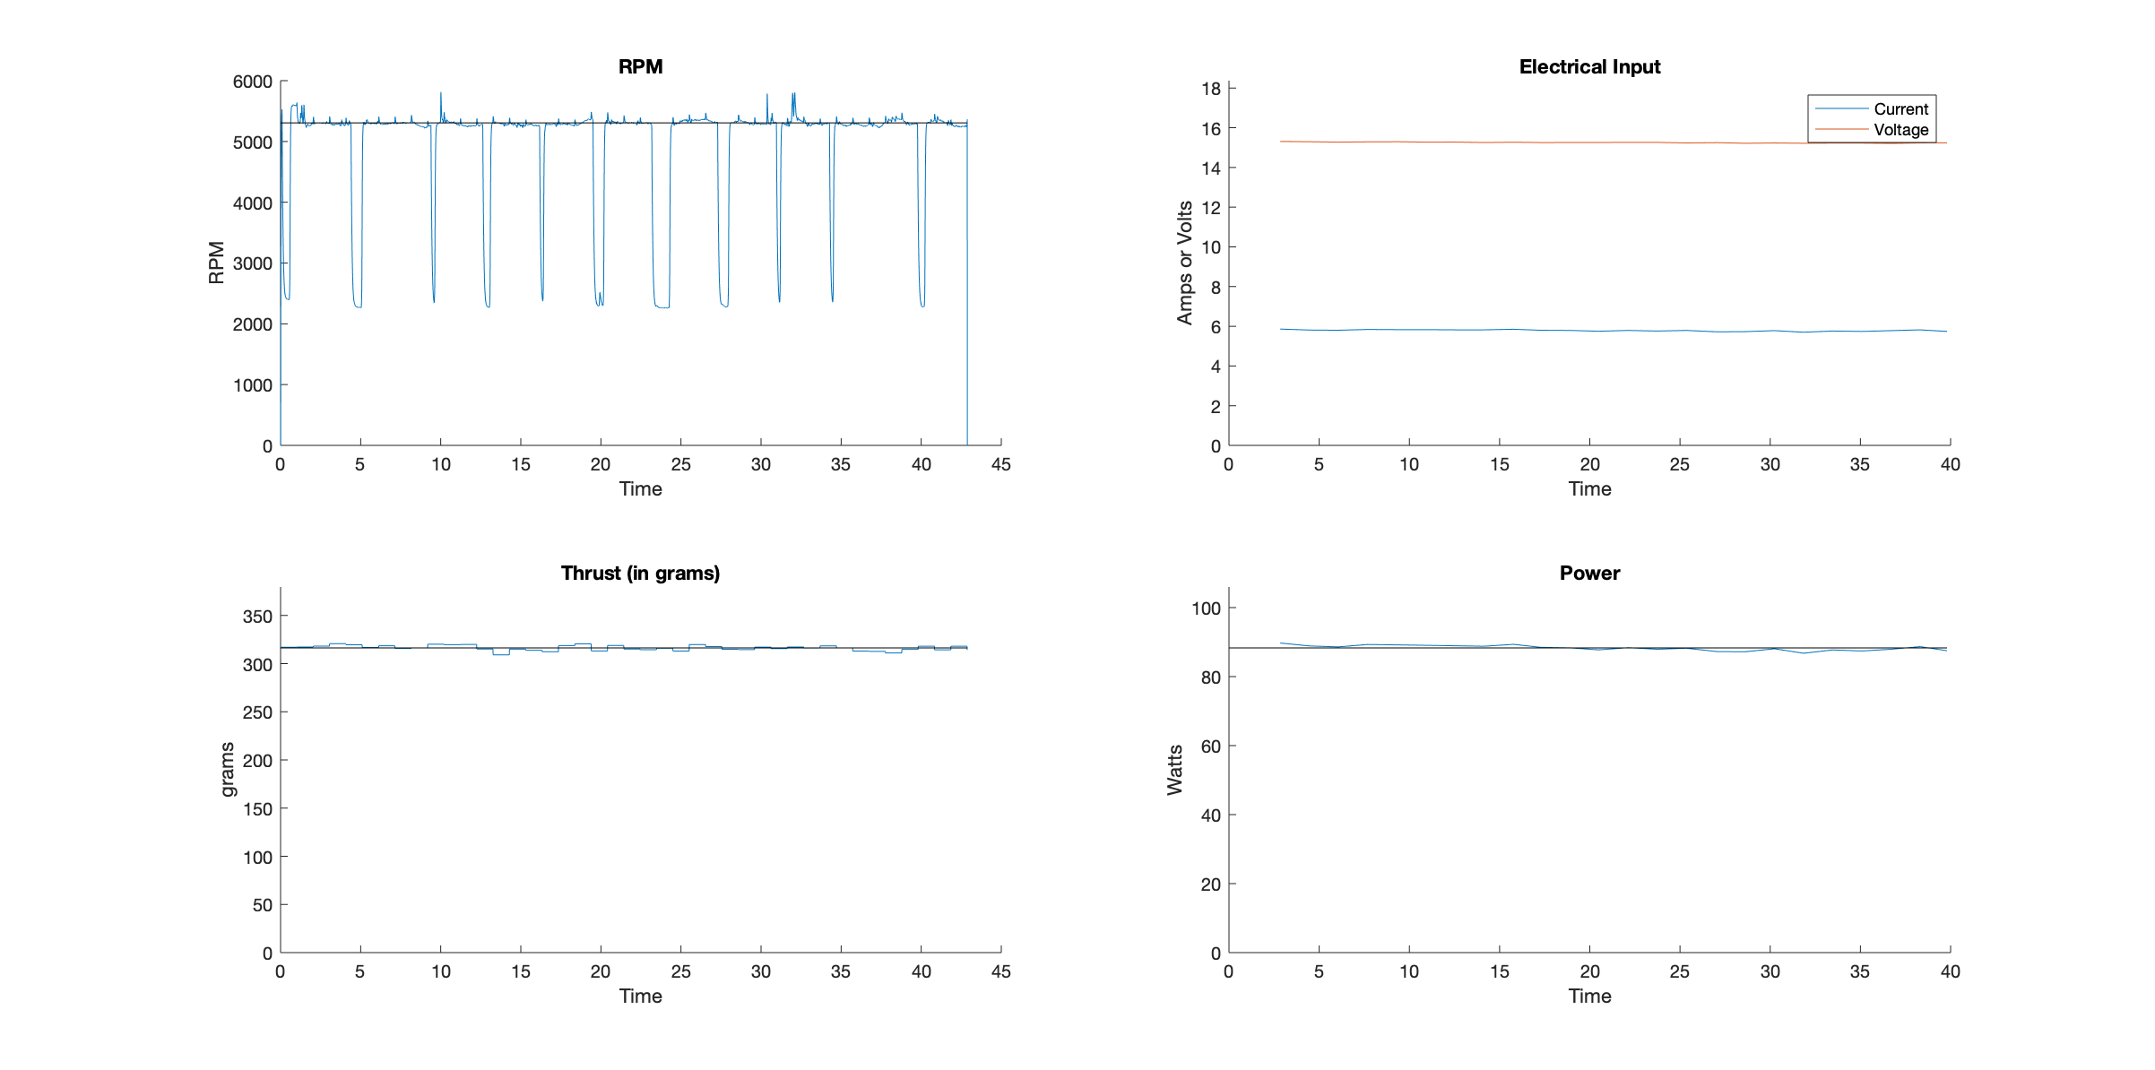
Raw collected data
(RPM Sensor)
(Pixhawk)
(Loadcell)
(Pixhawk)

Slide 4
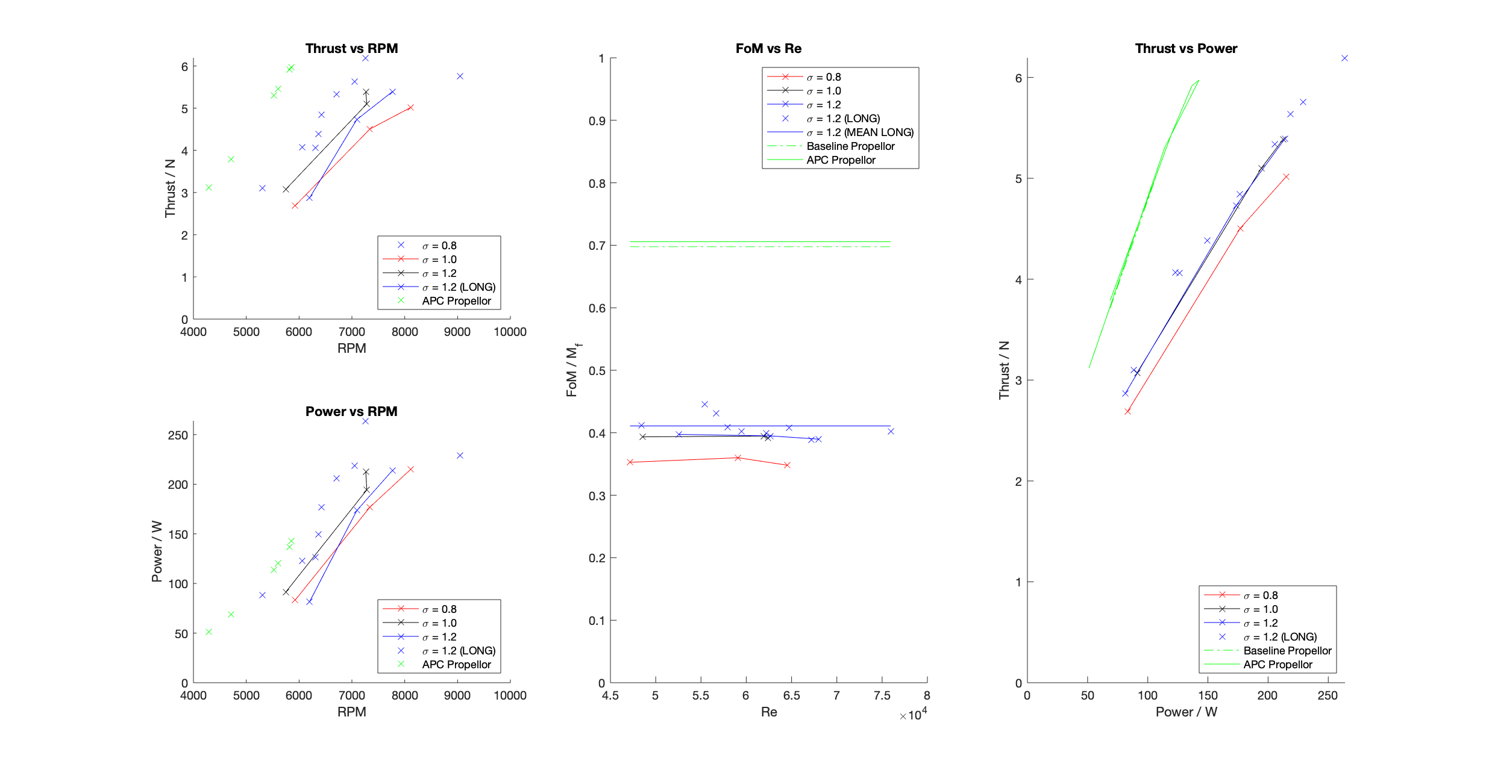
(Re out of range)
Mean value

Slide 5

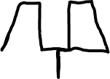

To do…
Drill tappings
3D the blades
New fan to loadcell mount to reduce oscillations and stop bending
Two-point mount instead of one
Try wide/short intake?
Big increase in FOM with longer intake
Increase in stability
What’s the turbo design saying?
After getting pressure info
Calibrate fan and motor.
Once the turbo design is improved so as not to double up on calibration waste

Slide 6
